Slide 1

Project: TA Report Web App
IE04 Weekly Progress Report, week 4
2023/11/15
Team: Pikachu

Slide 2
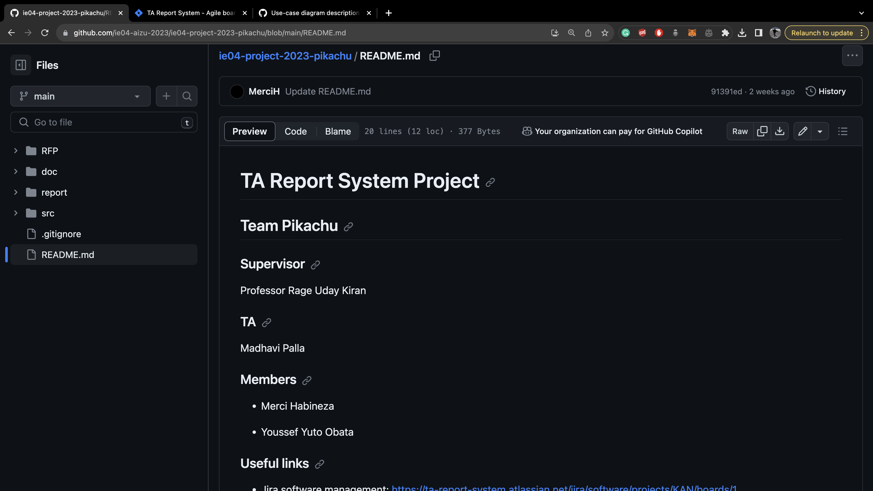

Slide 3
Activities of Previous Weeks
Task | Member | Work Hours
Sequence diagram | Youssef | 0:30
(UI design) login screen | Youssef | 5:30
(UI design) TA course screen | Merci | 9:30
(UI design) TA report screen | Merci | 8:30
(UI design) Faculty screen | Youssef | 4:30
(UI design) Administration screen | Youssef | 8:30
(UI design) Notification Tab | Youssef | 0:30
 | Total time: | 40h:00

Slide 4
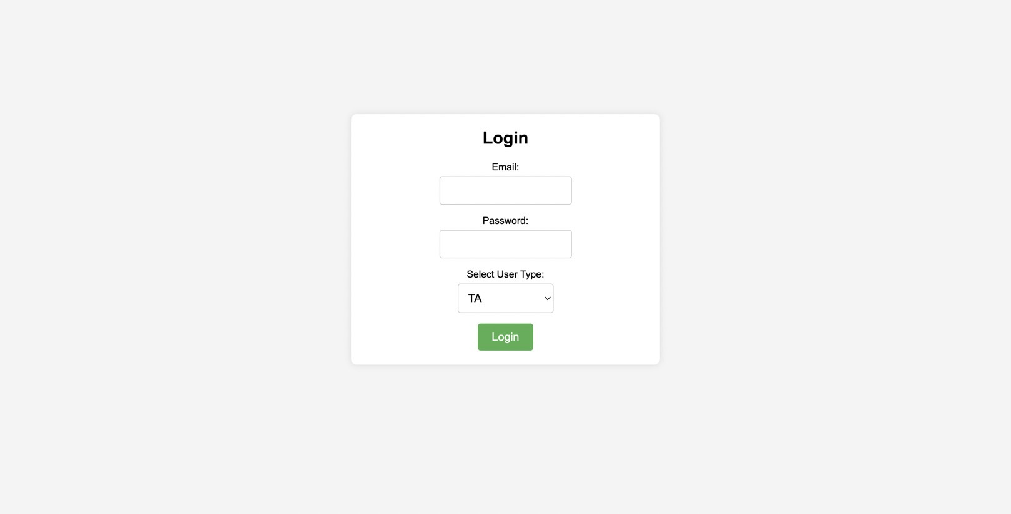
Login Screen

Slide 5
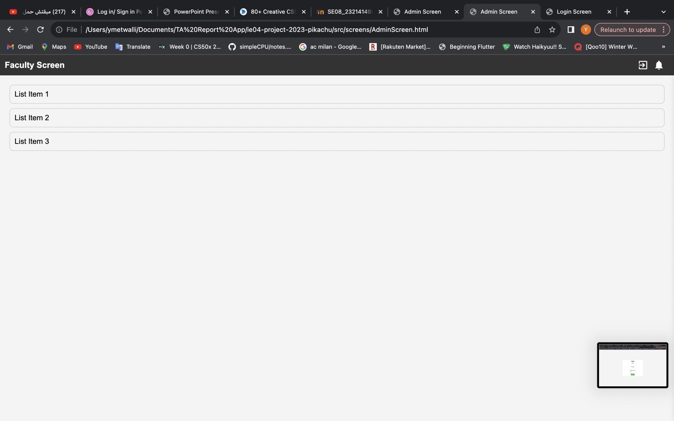

Slide 6
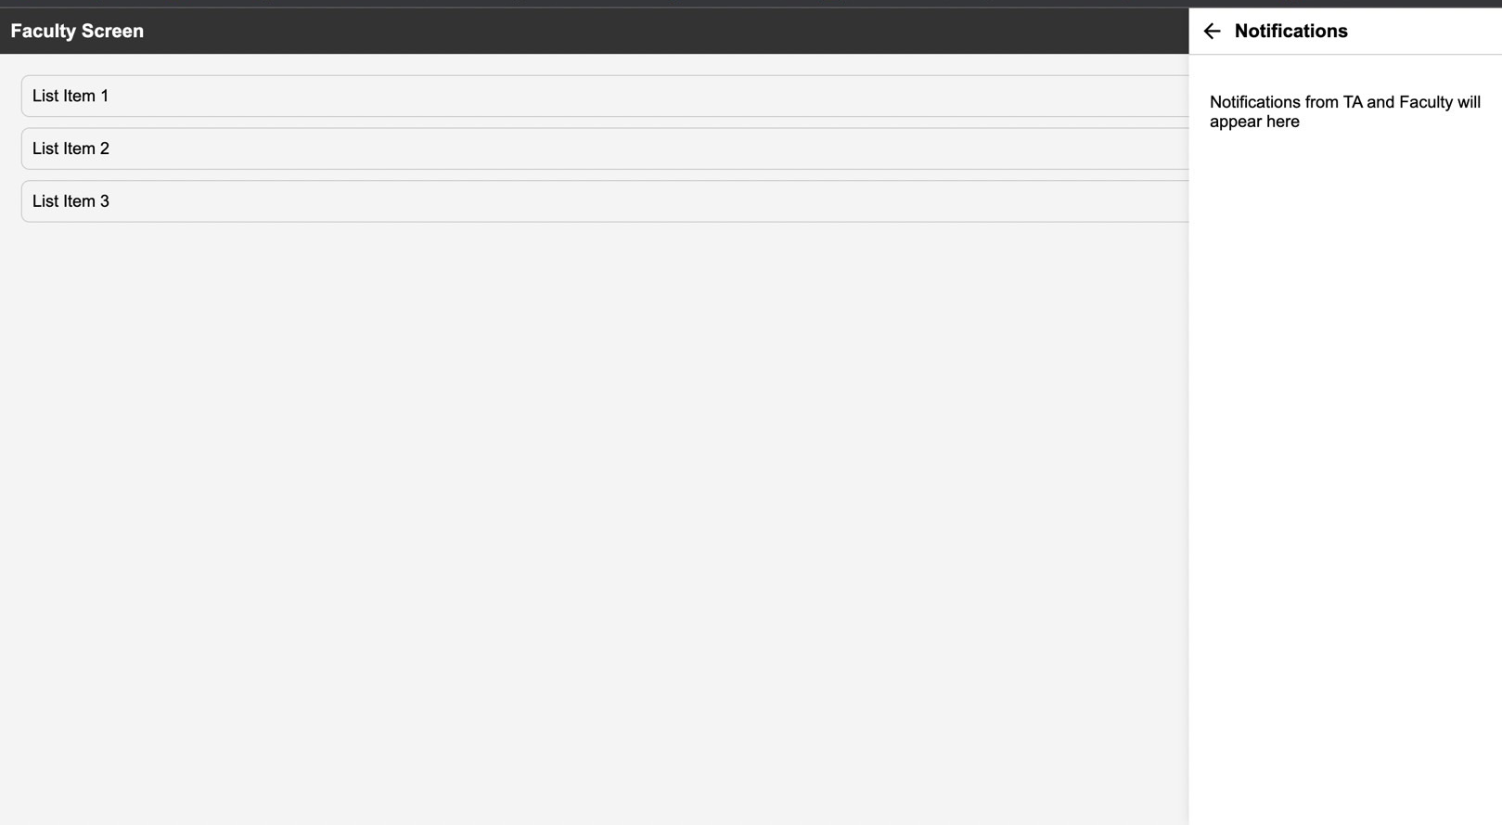
Notification Tab

Slide 7
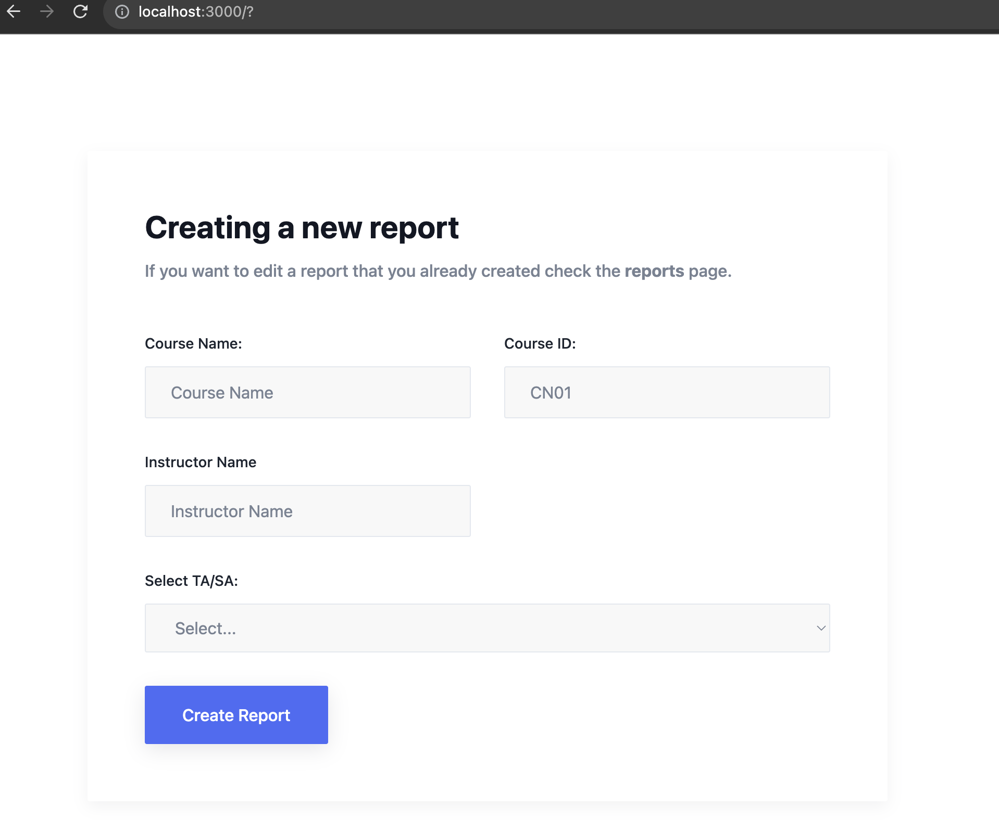
New Course Screen

Slide 8
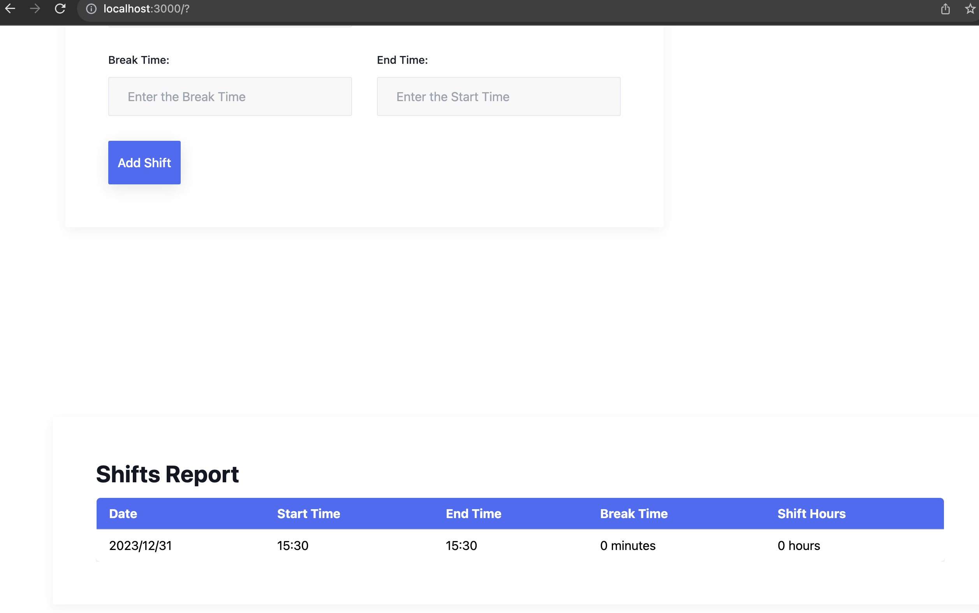
Report Screen

Slide 9
Plan for Next Week
Task | Member | Work Hours
Polish UI | Youssef &Merci | 0:30
Develop Database Logic | Youssef &Merci | 0:30
(Front-end) TA course screen | Merci | 0:30
(Front-end) TA report screen | Merci | 0:30
(Front-end) Faculty screen | Youssef | 0:30
(Front-end) Administration screen | Youssef
(Front-end) Notification Tab | Youssef | 0:30
 | Total time: | 00h:00

Slide 10
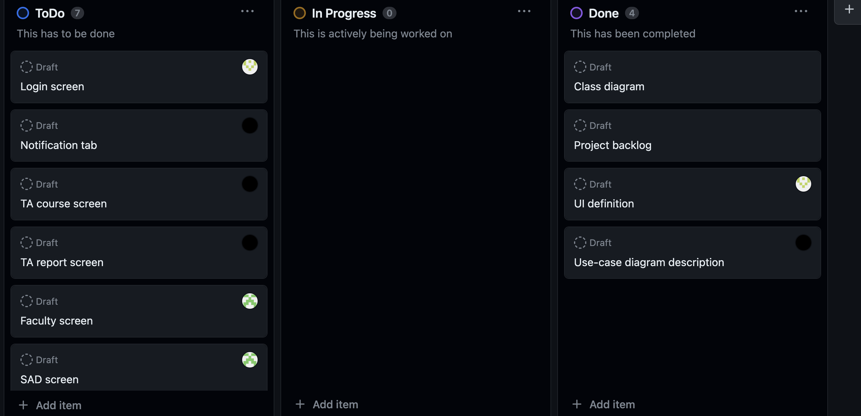
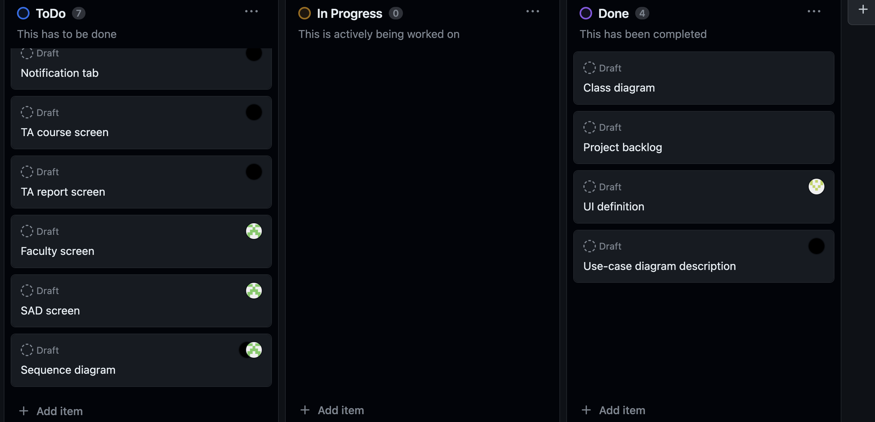
Phase Task Board

Slide 11
Issues & Risks (*if any)
Problem: None (NextJS is not easy ☹)
Cause
Possible Solution
Deadline

